Slide 1
恶意代码分析与防治技术
第8章 动态调试
王志
zwang@nankai.edu.cn
updated on 2022-11-6
南开大学 网络空间安全学院
2022/2023

Slide 2
本章知识点
源码级动态调试与汇编级动态调试
内核模式动态调试与用户模式动态调试
动态调试器的使用
Windows异常处理机制
恶意代码的动态修改

Slide 3
Source-Level vs. Assembly-Level Debuggers

Slide 4
Debugger
Is the debugger a piece of software or hardware?
Why we need a debugger?
  Why does a program give wrong results?
  What is a program doing?

Slide 5
Debugger
Give you insight into what a program is doing
  a dynamic view
Measure and control the internal state and execution of a program
  change anything at any time
  memory, register, argument to every function

Slide 6
Disassemblers vs. Debuggers
IDA Pro
  static overview of the whole program
Debugger
  dynamic accurate view of one concrete execution path
  change anything at any time during the execution

Slide 7
Two Debuggers
Ollydbg
  Most popular for malware analysis
  User-mode debugging only
  IDA Pro has a built-in debugger, but it's not as easy to use or powerful as Ollydbg
Windbg
  Supports kernel-mode debugging

Slide 8
Source-Level vs. Assembly-Level Debuggers
Source-level
  operate on source code
  step through program execution one line at a time
Assembly-level
  Low-level debugger
  Operate on assembly code
  step through program execution one instruction at a time

Slide 9

单选题
10分
Which item below could view a sequence of CPU instructions execution ？
A
Source-level debugger
B
Assembly-level debugger
C
Disassembler
D
ProcessMoniter
提交

Slide 10
User Mode vs. Kernel Mode
Debuggers

Slide 11
User Mode vs. Kernel Mode
Review
  What is User Mode ?
  What is Kernel Mode ?
User mode debugger
debug user mode codes
Kernel mode debugger
debug kernel mode codes

Slide 12
User Mode Debugging
OS supports multiple user mode program execution at the same time
Debugger and the code being debugged could be running on the same OS.
OllyDbg

Slide 13
Kernel Mode Debugging
How many kernels on one OS?
What will happen when kernel is at a breakpoint?
Two computers for kernel mode debugging
  Two different kernels
  Enable kernel debugging

Slide 14
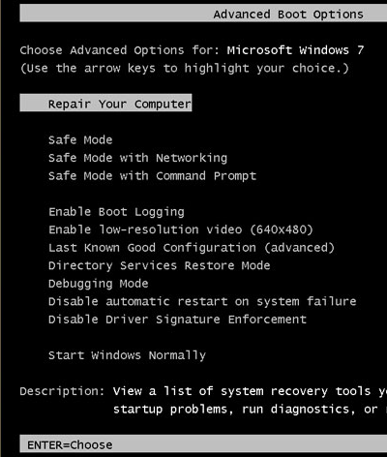
Windows 7 Advanced Boot Options
Press F8 during startup
"Debugging Mode"

Slide 15
单选题
10分
Which item below must require two computers connected together?
A
Source-level debugger
B
Kernel-mode debugger
C
User-mode debugger
D
Assembly-level debuger
提交

Slide 16
单选题
10分
Which item below is almost never used by malware analysts?
A
Source-level debugger
B
Assembly-level debugger
C
User-mode debugger
D
Kernel-mode debugger
提交

Slide 17
单选题
10分
Which item below is suggested by Windows automatically after it crashes?
A
Source-level debugger
B
Assembly-level debugger
C
User-mode debugger
D
Kernel-mode debugger
提交

Slide 18
Using a Debuggers

Slide 19
Two Ways
Start the program with the debugger
  It stops running immediately prior to the execution of its entry point
  debug malicious code

Slide 20
Two Ways
Attach a debugger to a program that is already running
  All its threads are paused
  debug a process that is affected by malware

Slide 21
Single-Stepping
Run a single instruction and then return control to the debugger
You can see everything
Time consuming and tedious for complex code
Focus on the big picture
Do not get lost in the details

Slide 22
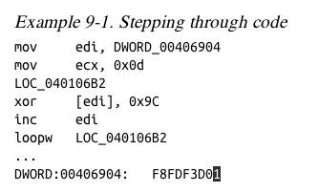
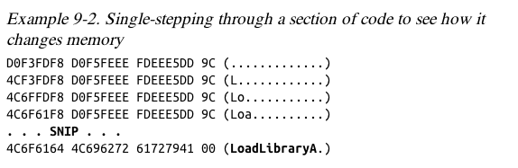
Example
This code decodes the string with XOR

Slide 23
Stepping-Over vs. Stepping-Into
Call instruction
  call a function, such as LoadLibrary
Stepping-over
  Complete the execution of the function
  Stop at the instruction after call instruction
Stepping-into
  Stop at the first instruction of the called function

Slide 24
Stepping Out
Stepping-Over
  Risk of missing important functionality
  Risk of never return
Stepping-Into
  Long nested call instructions
  No relevance to what you are seeking
Stepping-Out
  Run until after the function returns

Slide 25
多选题
10分
Which item might miss important functionality?
A
single-step
B
step-over
C
step-into
D
step-out
提交

Slide 26
多选题
10分
Which item will stop debugger at the first instruction of the called function?
A
single-step
B
step-into
C
step-over
D
step-out
提交

Slide 27
单选题
10分
Which item will run after the function returns?
A
single-step
B
step-into
C
step-out
D
step-over
提交

Slide 28
单选题
10分
Which item will stop at the first function after call instruction?
A
single-step
B
step-into
C
step-over
D
step-out
提交

Slide 29
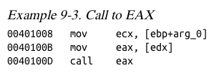
Pausing Execution with Breakpoints
Breakpoints stop execution
  Set breakpoints at interesting positions
Example
  You can't tell where this call is going
  Set a breakpoint at the call and see what's in eax

Slide 30
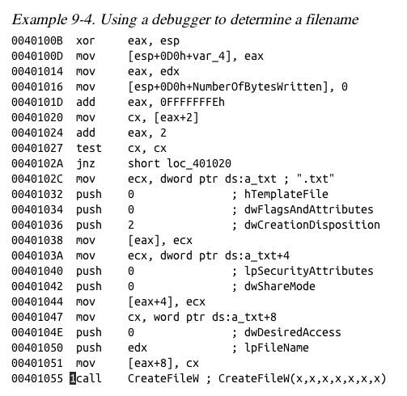
This code calculates a filename and then creates the file
Set a breakpoint at CreateFileW and look at the stack to see the filename

Slide 31
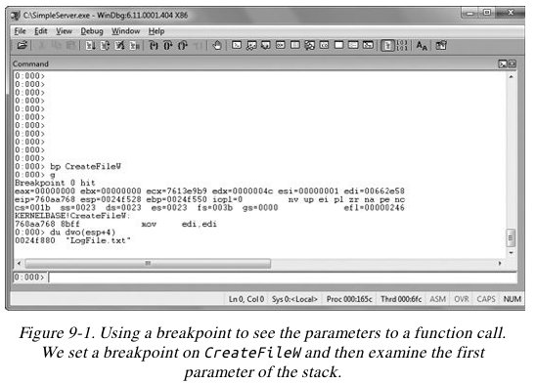
WinDbg

Slide 32
Encrypted Data
Suppose malware sends encrypted network data
Set a breakpoint before the data is encrypted and view it

Slide 33
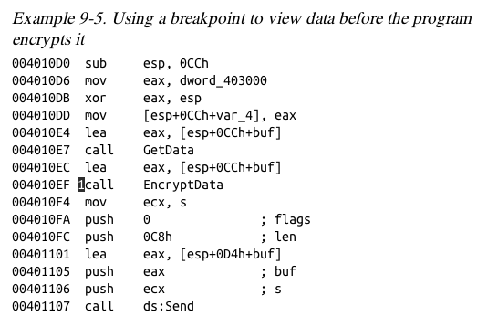

Slide 34
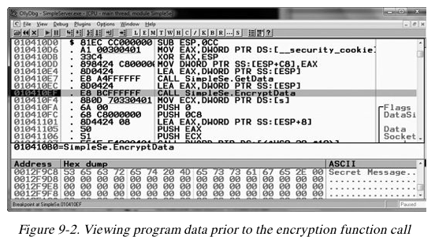
OllyDbg

Slide 35
Types of Breakpoints
Software execution breakpoint
Hardware execution breakpoint
Conditional breakpoint

Slide 36
Software Execution Breakpoints
Set breakpoints at specified instructions
Debugger overwrites the first byte of the instruction with 0xCC
  The instruction for INT 3
  An interrupt designed for use with debuggers
  When the breakpoint is executed, the OS generates an exception and transfers control to the debugger

Slide 37
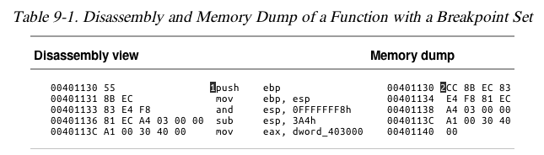
Memory Contents at a Breakpoint
There's a breakpoint at the push instruction
Debugger says it's 0x55, but it's really 0xCC

Slide 38
When Software Execution Breakpoints Fail
If the 0xCC byte is changed during code execution, the breakpoint won't occur
If other code reads the memory containing the breakpoint, it will read 0xCC instead of the original byte
Code that verifies integrity will notice the discrepancy

Slide 39
Hardware Execution Breakpoints
Four Hardware Debug Registers
  DR0 through DR3 – addresses of breakpoints
  DR7 stores control information
if (EIP == Breakpoints) by hardware
Can break on access or execution
  Can set to break on read, write, or both
No change in code bytes

Slide 40
Hardware Execution Breakpoints
Running code can change the DR registers, to interfere with debuggers
General Detect flag in DR7
  Causes a breakpoint prior to any mov instruction that would change the contents of a Debug Register
  Does not detect other instructions, however

Slide 41
Conditional Breakpoints
Breaks only if a condition is true
  Ex: Set a breakpoint on the GetProcAddress function
  Only if parameter being passed in is RegSetValue
Implemented as software breakpoints
  The debugger always receives the break
  If the condition is not met, it resumes execution without alerting the user

Slide 42
Conditional Breakpoints
Conditional breakpoints take much longer than ordinary instructions
A conditional breakpoint on a frequently-accessed instruction can slow a program down

Slide 43
多选题
10分
What type of breakpoint uses Interrupt #3?
A
software breakpoint
B
hardware breakpoint
C
conditional breakpoint
D
single step
提交

Slide 44
多选题
10分
What type of breakpoint may make a program run slowly?
A
software breakpoint
B
hardware breakpoint
C
conditional breakpoint
提交

Slide 45
多选题
10分
What type of breakpoint changes the binary code?
A
software breakpoint
B
hardware breakpoint
C
conditional breakpoint
提交

Slide 46
多选题
10分
What type of breakpoint uses the DR registers?
A
software breakpoint
B
hardware breakpoint
C
conditional breakpoint
提交

Slide 47
单选题
10分
做多设置几个硬件中断？
A
1
B
2
C
4
D
8
提交

Slide 48
Exceptions

Slide 49
Exceptions
What is the exception?
  Error?
  Fault?
How many different exceptions？

Slide 50
Exceptions
Used by debuggers to gain control of a running program
Breakpoints generate exceptions
  Software BP
  Hardware BP
  Conditional BP

Slide 51
Exception
Exceptions are also caused by
  Access violation
  Division by zero
  Stack overflow

Slide 52
First- and Second-Chance Exceptions
Debuggers are usually given two opportunities to handle the same exception
  First-chance exception
  Second-chance exception

Slide 53
First- and Second-Chance
When a exception occurs while a debugger is attached
  The program stops executing
  The debugger is given first chance at control
  Debugger can either handle the exception, or pass it on to the program
  If it's passed on, the program's exception handler SEH takes it

Slide 54
Second Chance
If the application doesn't handle the exception
The debugger is given a second chance to handle it
  This means the program would have crashed if the debugger were not attached

Slide 55
Second Chance
In malware analysis, first-chance exceptions can usually be ignored
Second-chance exceptions cannot be ignored
  They usually mean that the malware doesn't like the environment in which it is running

Slide 56
多选题
10分
Which item below handles exceptions during normal program execution and debugger attached?
A
First chance
B
Second chance
C
SEH
D
INT 3
提交

Slide 57
主观题
10分
When analyzing malware, why the first-chance exceptions can often be ignored?
正常使用主观题需2.0以上版本雨课堂
作答

Slide 58
主观题
10分
In malware analysis, why the second chance exception cannot be ignored?
正常使用主观题需2.0以上版本雨课堂
作答

Slide 59
Common Exceptions
INT 3: Software Breakpoint Trap
  0xCC
INT 1: Single-stepping Trap
  If the trap flag in the flags register is set
  The processor executes one instruction and then generates an exception

Slide 60
Common Exception
Memory-access violation exception
  Code tries to access a location that it cannot access, either because the address is invalid or because of access-control protections

Slide 61
Common Exceptions
Violating Privilege Rules
  Attempt to execute a kernel mode instruction in user mode
  Attempt to execute Ring 0 instruction from Ring 3

Slide 62
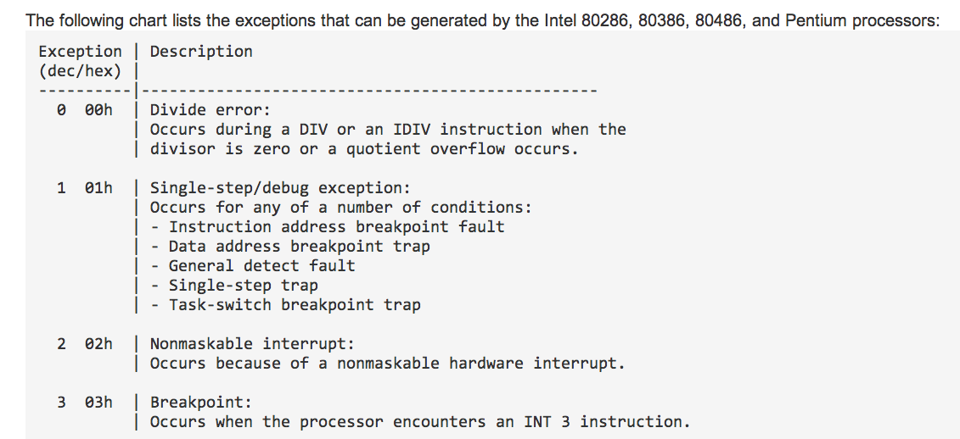
List of Exceptions

Slide 63
多选题
10分
Which item could cause an exception?
A
Access violation
B
Division by zero
C
Stack overflow
D
Breakpoint
提交

Slide 64
多选题
10分
Which item is used for single-stepping?
A
first chance
B
second chance
C
SEH
D
INT 3
E
trap flag
提交

Slide 65
多选题
10分
Which type of exception usually is ignored for malware analysis?
A
First chance
B
Second chance
C
SEH
D
INT 3
E
trap flag
提交

Slide 66
多选题
10分
A ring 3 process tries to access hardware directly. What exception will be thrown?
A
First chance
B
Second chance
C
/0
D
Invalid memory access
E
Privilege violation
提交

Slide 67
Modifying Execution with a Debugger

Slide 68
Modifying Execution with a Debugger
Why we have to modify the malware execution?
  Skipping a function
  Testing a function

Slide 69
Skipping a Function
We can change control flags, the instruction pointer, or the code itself
We can avoid a function call by setting a breakpoint where at the call, and then changing the instruction pointer to the instruction after it
  This may cause the program to crash or malfunction, or course

Slide 70
Testing a Function
You could run a function directly, without waiting for the main code to use it
  You will have to set the parameters
  This destroys a program's stack
  The program won't run properly when the function completes

Slide 71
多选题
10分
Using binary modification, which operation we could do?
A
skip a function
B
test a function
C
software cracking
D
code reuse
提交

Slide 72
Modifying Program Execution in Practice

Slide 73
Real Virus
Operation depends on language setting of a computer
  Simplified Chinese
    Uninstalls itself & does no harm
  English
    Display pop-up "Your luck's no good"
  Japanese or Indonesian
    Overwrite the hard drive with random data

Slide 74
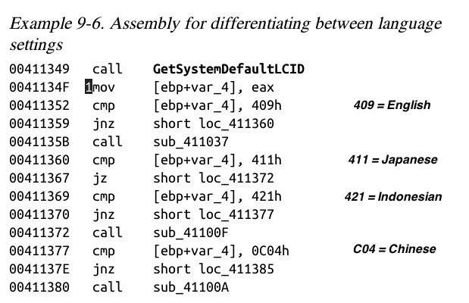
Break at 1; Change Return Value

Slide 75
Internal Logic
English, loc_411360
Japanese, loc_41372
Indonesian, loc_411377
Chinese, loc_411385

Slide 76
多选题
10分
How to force the malicious code to run different path without changing the settings on our system?
A
Modify instruction pointer
B
Change Windows API return value
C
Breakpoint
D
Set trap flag
提交

Slide 77
Conclusion

Slide 78
Conclusion
Debugging
  obtaining running information
  single-step what’s happening internally
  set breakpoint to see particular section of code
  modify code to get additional information

Slide 79
Next Chapters
Debugging
  OllyDbg
  WinDbg

Slide 80
Outline
Source-Level vs. Assembly-Level Debuggers
Kernel vs. User-Mode Debugging
Using a Debugger
Exceptions
Modifying Execution with a Debugger

Slide 81
恶意代码分析与防治技术
第8章 动态调试
王志
zwang@nankai.edu.cn
updated on 2022-11-6
南开大学 网络空间安全学院
2022/2023

